Slide 1
INTERNET OF THINGS
DEPT:COMPUTER AND COMMUNICATION ENGINEERING

Slide 2
INTERNET OF THINGS
INTRODUCTION
IoT with AI & Machine Learning
Edge & Cloud Computing in IoT
IoT in Agriculture
IoT in Transport

Slide 3
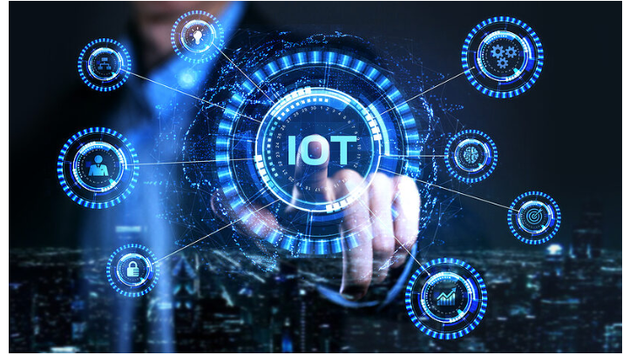
INTRODUCTION
The Internet of Things (IoT) is a rapidly evolving technology that connects physical devices, sensors, and systems through the internet to collect and exchange data. Emerging IoT technologies combine artificial intelligence, cloud computing, and low-power communication to enable smarter automation and real-time decision-making. IoT plays a critical role in smart cities, healthcare, agriculture, transport, and energy sectors. This paper presents an overview of key emerging IoT technologies and their real-world applications

Slide 4
IoT with AI & Machine Learning
The integration of Artificial Intelligence (AI) and Machine Learning (ML) with IoT enables systems to analyze large volumes of sensor data and learn patterns automatically.
AI-powered IoT systems can predict failures, detect anomalies, and optimize operations without human intervention.
Applications include predictive maintenance in industries, smart surveillance, healthcare monitoring, and intelligent home automation.
ML algorithms enhance accuracy and adaptability of IoT systems

Slide 5
Edge & Cloud Computing in IoT
Edge computing processes data closer to the source, reducing latency and bandwidth usage, while cloud computing provides centralized storage, large-scale analytics, and system management.
A hybrid edge-cloud architecture improves efficiency and scalability in IoT deployments.
Real-time applications such as traffic control, industrial automation, and smart surveillance rely on edge computing, while cloud platforms support long-term analysis and AI model training.

Slide 6
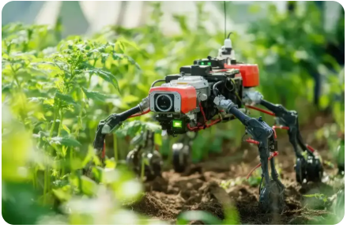
IoT in Agriculture
IoT technologies support precision agriculture by enabling real-time monitoring of soil moisture, temperature, humidity, and crop health.
Automated irrigation systems reduce water wastage, while weather sensors improve crop planning.
Farmers benefit from increased yield, reduced operational cost, and sustainable farming practices.
IoT-driven agriculture enhances food security and environmental protection

Slide 7
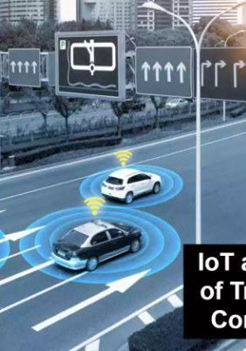
IoT in Transport
IoT applications in transportation include vehicle tracking, traffic monitoring, smart parking, and fleet management.
Sensors and GPS devices provide real-time data to optimize routes, reduce fuel consumption, and enhance safety.
Smart transport systems help cities manage congestion efficiently and improve public transportation reliability

Slide 8
Conclusion
Emerging IoT technologies are transforming industries by enabling intelligent automation, efficiency, and data-driven decision-making.
The integration of AI, edge computing, and low-power communication will shape the future of IoT systems.

Slide 9
Reference
IEEE Internet of Things Journal
Cisco IoT Technology White Papers
Gartner Research on IoT
NIST IoT Architecture FrameworK

Slide 10
Thank you

